Slide 1

Interactive Touch Me Not Game: Arduino UNO and Closed Circuit Principles
L Vinay Kumar Reddy
(Dept. of Computer Science.)
Christ University
MISSION
CHRIST is a nurturing ground for an individual’s holistic development to make effective contribution to the society in a dynamic environment
VISION
Excellence and Service
CORE VALUES
Faith in God | Moral Uprightness Love of Fellow Beings
Social Responsibility | Pursuit of Excellence

Slide 2
CHRIST
Deemed to be University
AGENDA
Introduction.
Objectives.
What is Arduino UNO?
Features and Advantages of Arduino UNO.
Components available in Arduino board.
Explaining the working.
Conclusion.
Excellence and Service

Slide 3
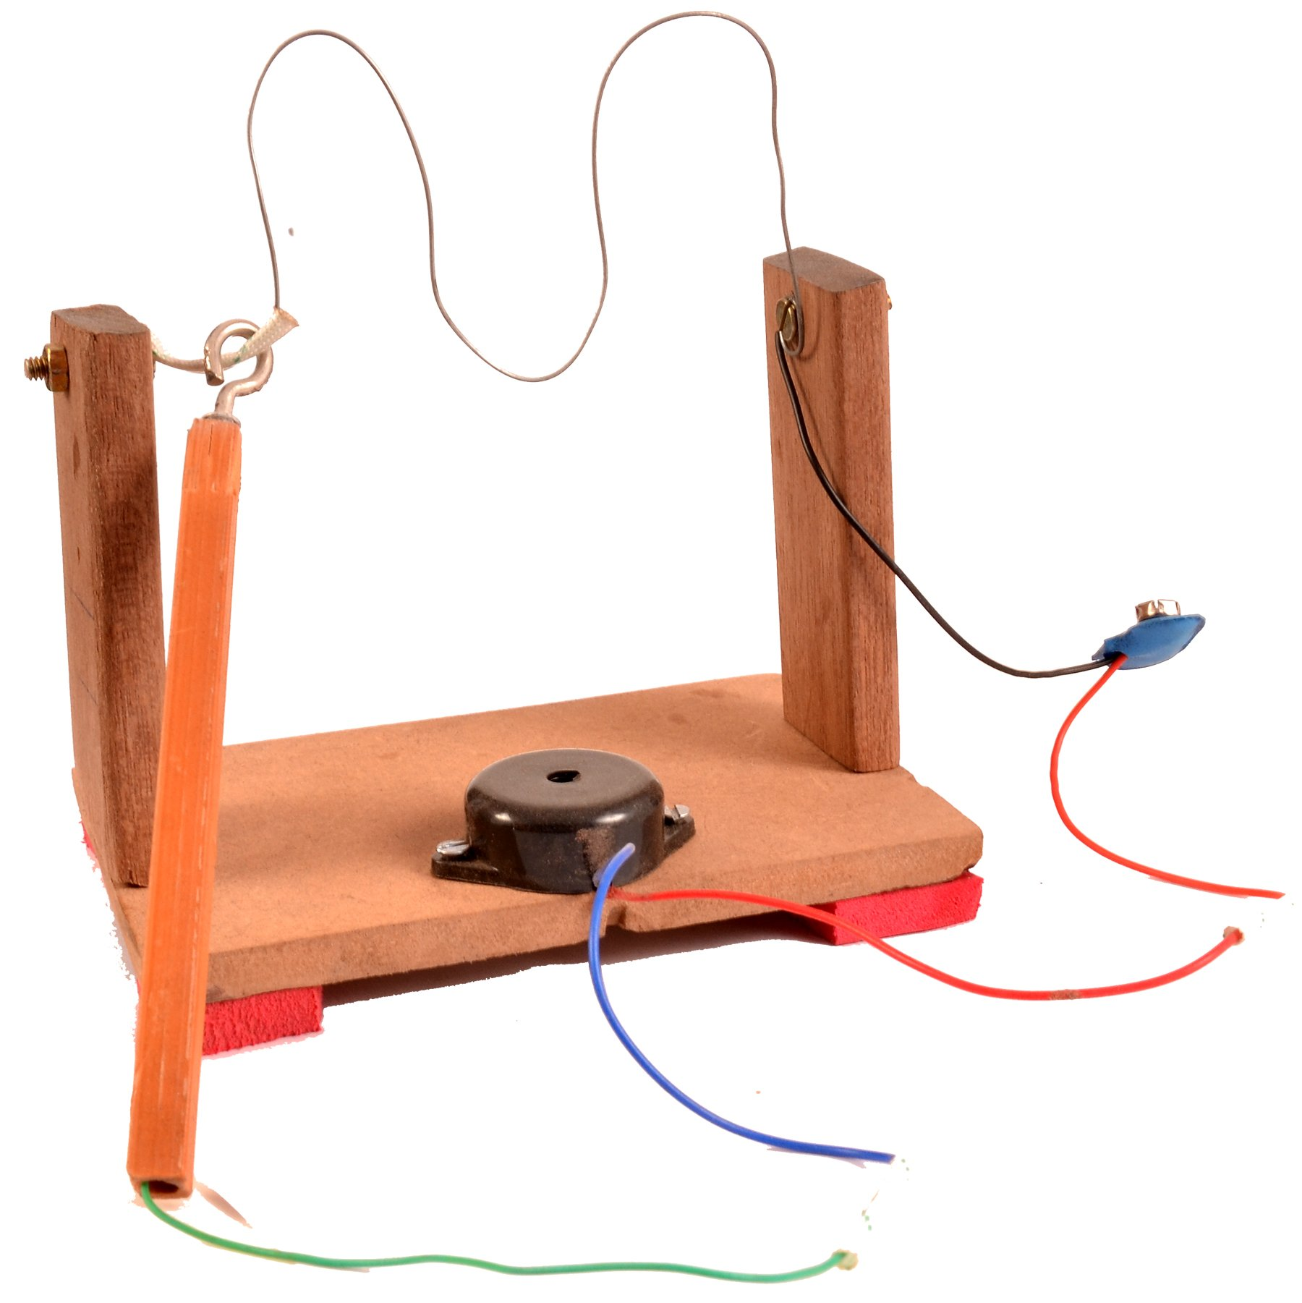
CHRIST
Deemed to be University
1. Introduction
In this paper, we present an implementation of the current passes through a closed circuit principle using Arduino UNO. Arduino UNO is a microcontroller board that can create interactive electronic devices. Our implementation of the current passes through a closed circuit principle using Arduino UNO consists of a simple circuit with a switch, a buzzer, and an LED. When the switch is closed, the current flows through the circuit and the buzzer beeps and the LED turns on. When the switch is open, the circuit is broken and the buzzer stops beeping and the LED turns off.
Excellence and Service

Slide 4
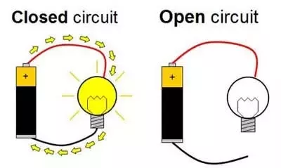
CHRIST
Deemed to be University
2. Objectives
The objectives are to implement the ”current passes through a closed circuit” principle in a Touch Me Not game using an Arduino Uno, which can be an educational and engaging project. The objective of this project is to teach users about the basic principles of electrical circuits and how they can be used in a fun and interactive way.
Excellence and Service

Slide 5
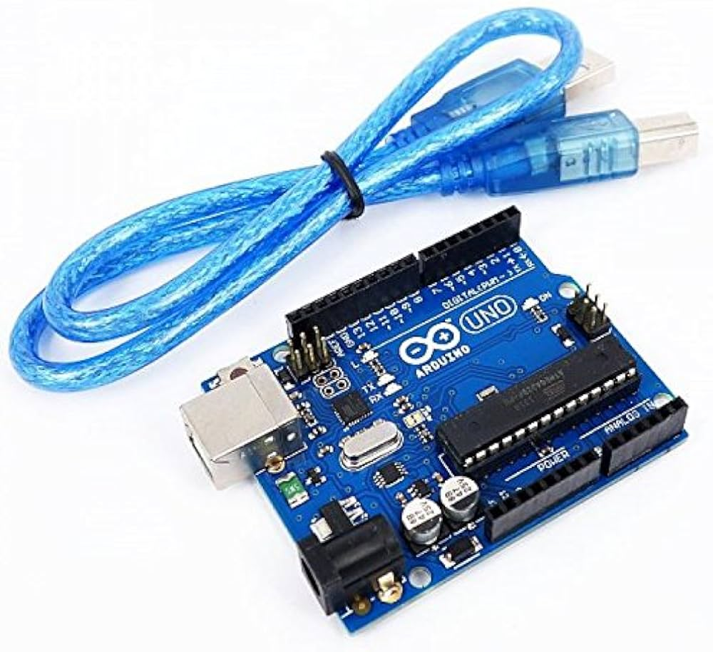
CHRIST
Deemed to be University
3. What is Arduino UNO
Arduino UNO is a microcontroller board developed by Arduino.cc based on the Atmega328 Microcontroller. The first Arduino project was started at Interaction Design Institute Ivrea in 2003 by David Cuartielles and Massimo Banzi to provide a cheap and flexible way for students and professionals to learn embedded programming.
Arduino UNO is a very valuable addition to electronics that consists of a USB interface, 14 digital I/O pins(of which 6 Pins are used for PWM), six analog pins, and an Atmega328 microcontroller. It also supports three communication protocols: Serial, I2C, and SPI.
Excellence and Service

Slide 6
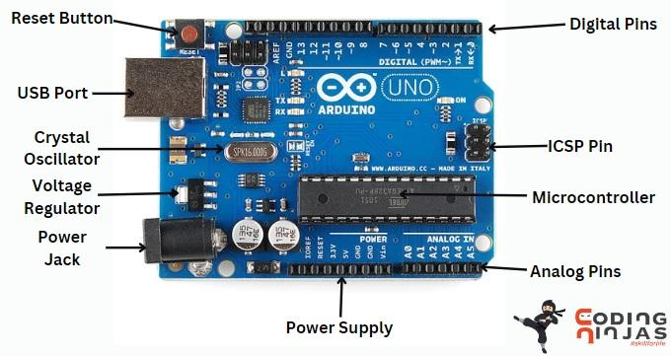
CHRIST
Deemed to be University
5. Physical Components
Excellence and Service

Slide 7
CHRIST
Deemed to be University
5. Physical Components
Microcontroller
Arduino Uno Board is an open-source microcontroller board powered by an ATmega328p processor.
Input/Output Pins
It comprises 14 input and output pins with 6 analog input pins. These pins are used to connect Arduino boards to different electronic components.
Power Supply
The power supply components include IOREF, GND, 3.3V, 5V, and Vin, which connect sensors. Voltage regulators regulate the Power supply of the Arduino Uno board.
LED
LED indicators are used in Arduino Uno, which is used for debugging or indicating a signal.
Reset Button
A reset button is used to restart the microcontroller.
USB Interface
It consists of a USB port to upload the program to the arduino uno board.
Voltage Regulator
It provides a stable and reliable voltage supply to the board's components.
ICSP Pin
It programs the microcontroller and performs functions like debugging the code.
Crystal Oscillator
It is an electronic oscillator that is used to create stable and precise frequency signals.
Excellence and Service

Slide 8
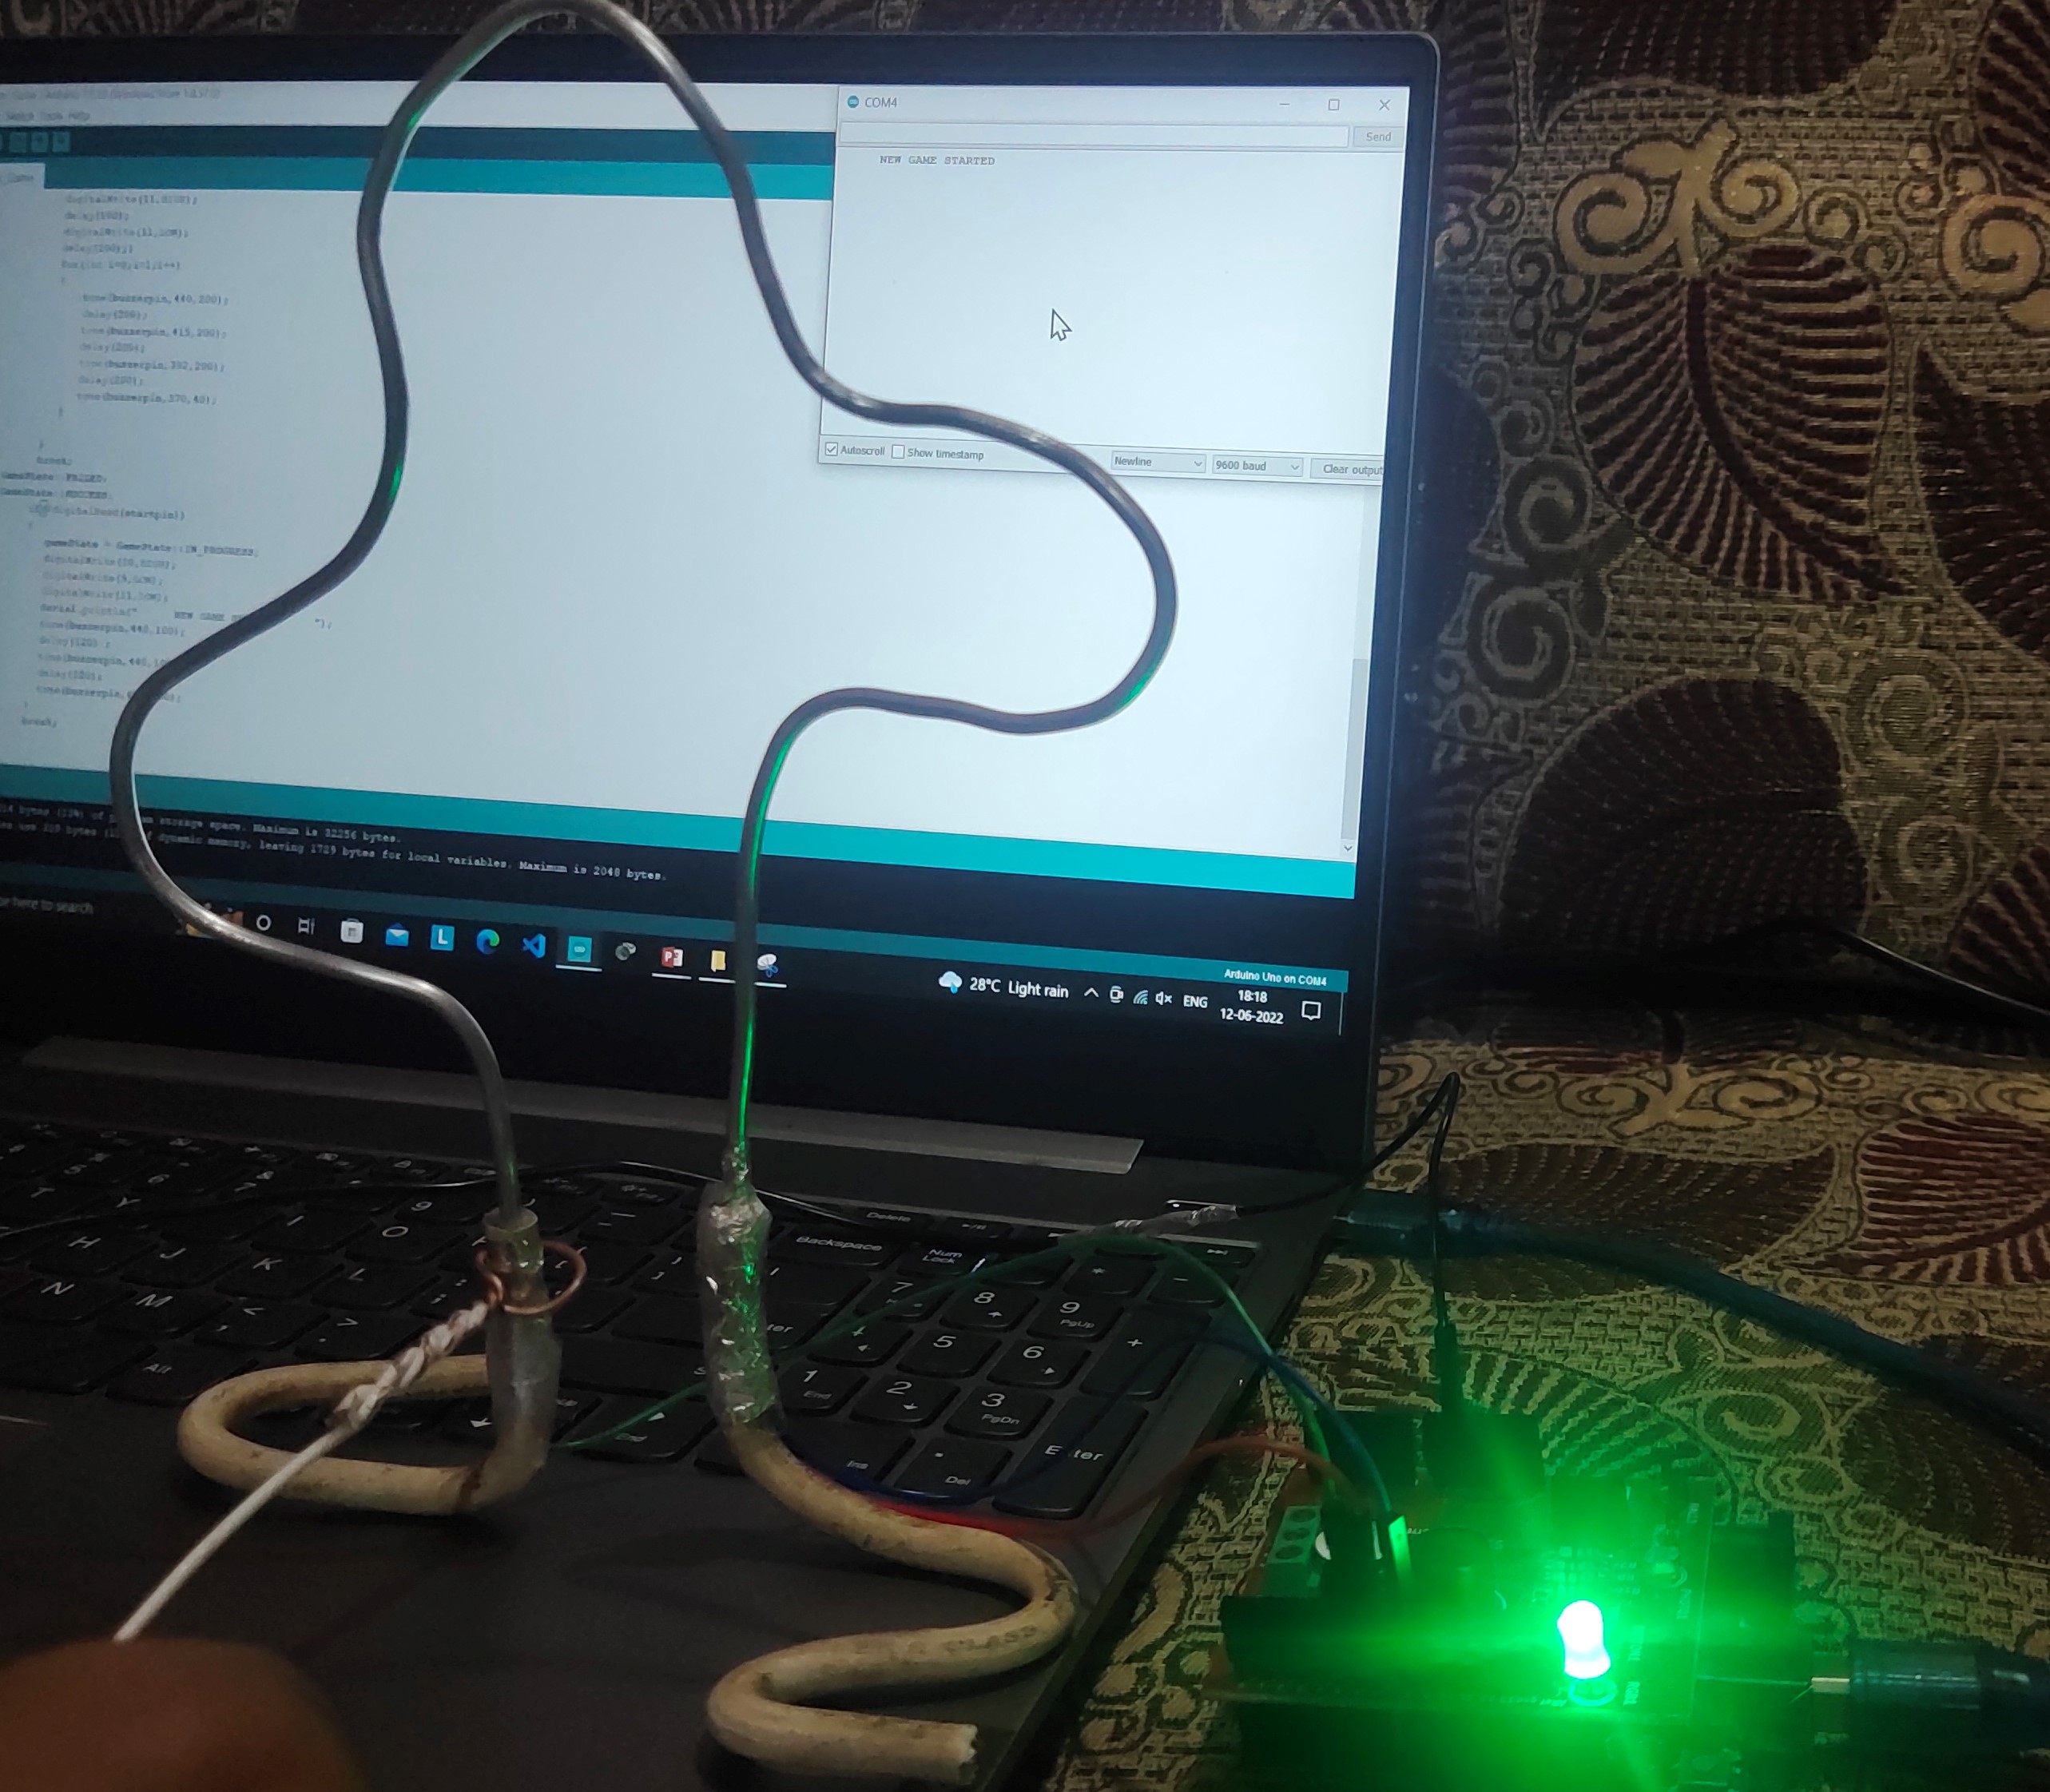
CHRIST
Deemed to be University
6. Explaining the working.
Start Point
The Handle is brought in contact with the start point to start the game. The Handle when touched at the start point, the LED turns green and indicates that the player is ready to start the game.
START POINT
Excellence and Service

Slide 9
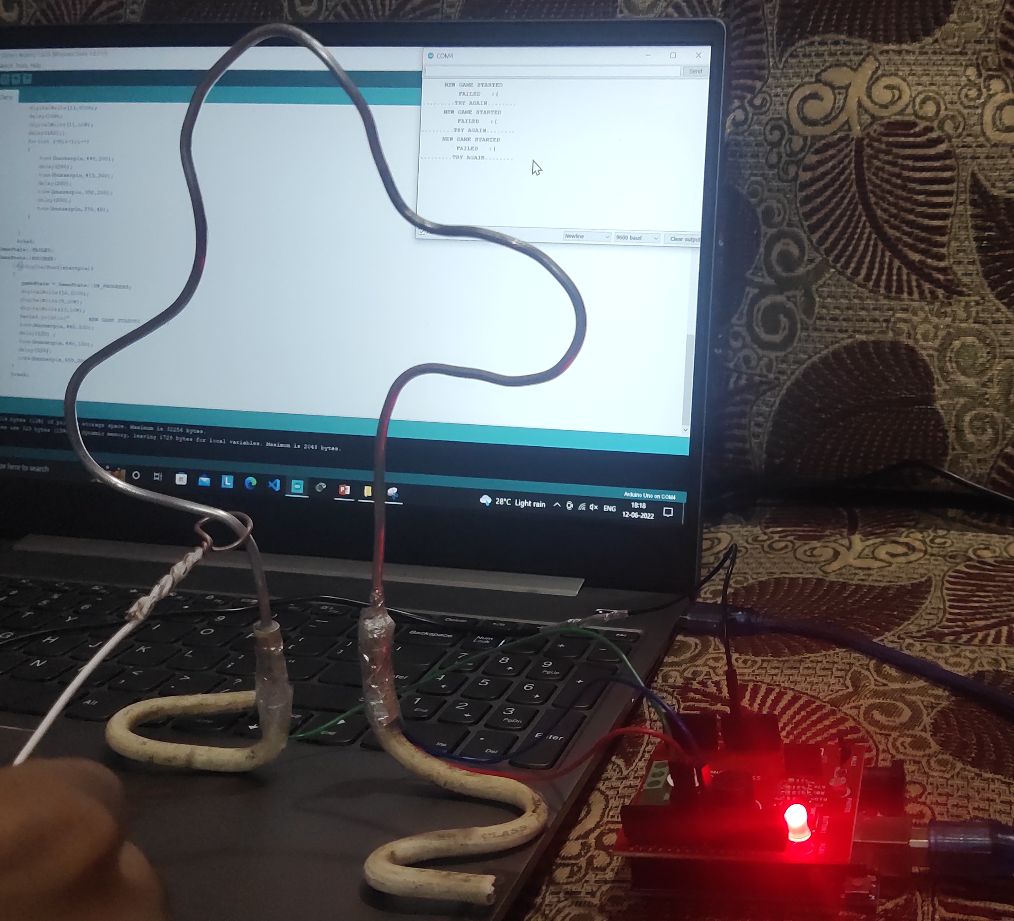
CHRIST
Deemed to be University
Explaining the working.
B. Fail Point
The Player, after the game has started, has to move the handle along the track without touching the way. When the player touches the track, the LED turns red and a buzz is heard from the buzzer meaning that the player has failed to reach the finish point without touching the track and has to restart the game by going back to the start point. In this state, even when the player reaches the final point, there is no celebration or buzzer from the board as it is now in the fail state. To reset it, the player must only restart the game from the start point.
FAIL POINT
Excellence and Service

Slide 10
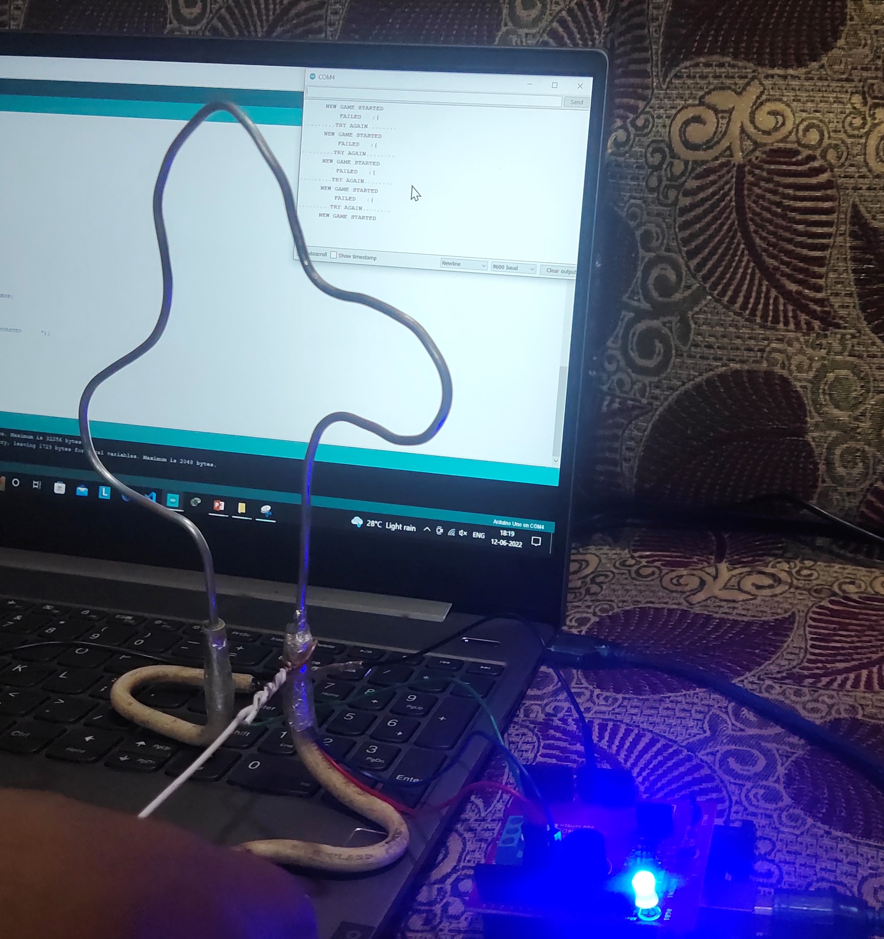
CHRIST
Deemed to be University
6. Explaining the working.
C. Finish Point
The Player, after starting the game and without touching the track with the handle, reaches the final point and touches the final point with the handle. The LED turns blue, red, and green with multiple buzzes, indicating that the player has won the game.
FINISH POINT
Excellence and Service

Slide 11
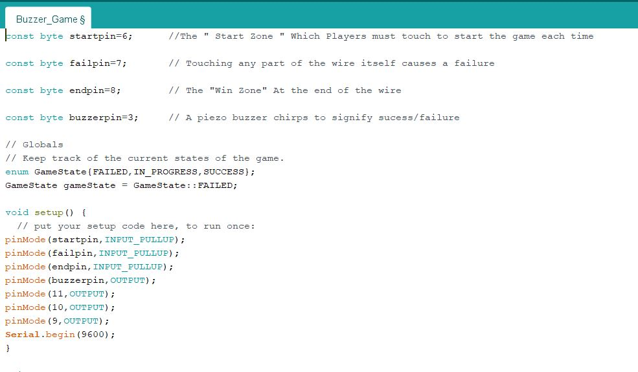
CHRIST
Deemed to be University
Working Code
Excellence and Service

Slide 12
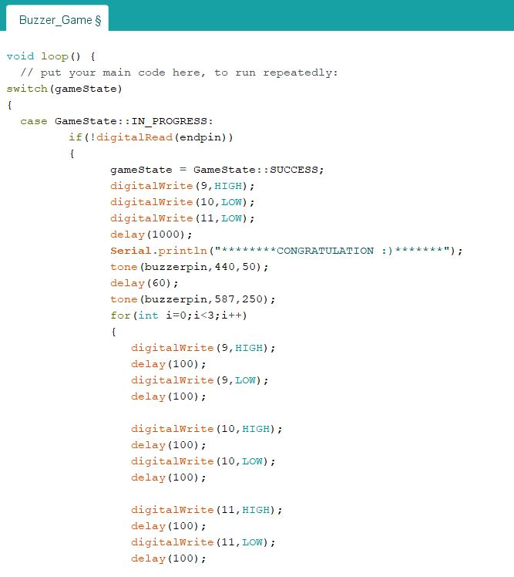
CHRIST
Deemed to be University
Working Code
Excellence and Service

Slide 13
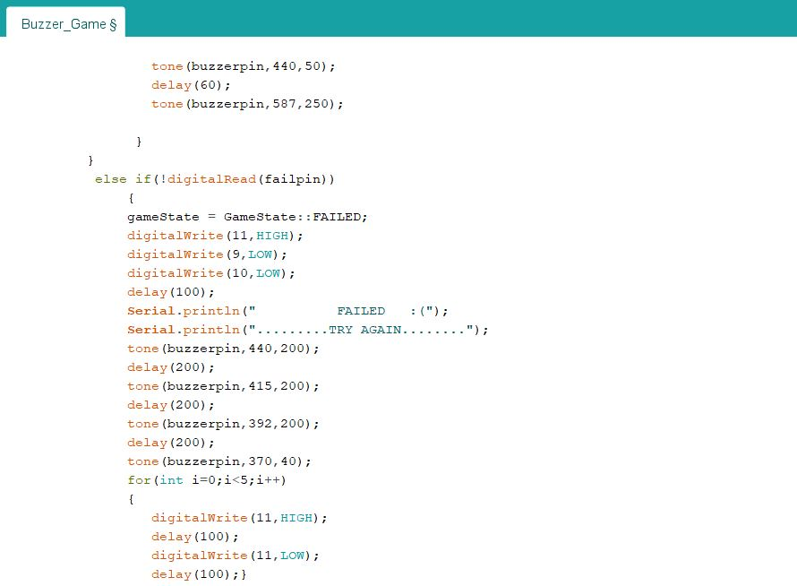
CHRIST
Deemed to be University
Working Code
Excellence and Service

Slide 14
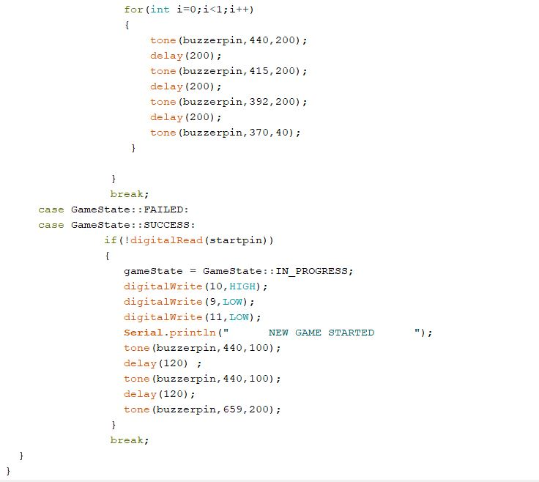
CHRIST
Deemed to be University
Working Code
Excellence and Service

Slide 15
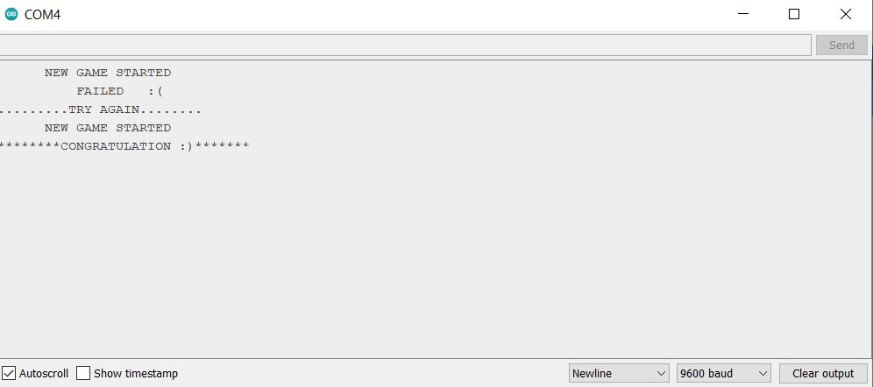
CHRIST
Deemed to be University
Output Screen on Different States
Excellence and Service

Slide 16
CHRIST
Deemed to be University
7. Conclusion
In conclusion, this research paper highlights the development of an interactive ”Touch Me Not” game using Arduino UNO as an educational tool for teaching closed circuit principles. The game offers an engaging and effective learning experience by combining theoretical concepts with hands-on experimentation, making it a valuable addition to STEM education. It promotes active engagement, accessibility, interdisciplinary learning, scalability across different age groups, and the demonstration of real-world applications. This innovative approach has the potential to reshape how closed-circuit principles are taught, preparing students for the digital age and fostering a lasting passion for learning in the fields of science and engineering.
Excellence and Service

Slide 17
CHRIST
Deemed to be University
Thank You
Excellence and Service

